Slide 1
C3 Product Recommender

Slide 2
Agenda
Item
Team Participants
Motivation and Project Objective / Context
Methodology
Experiments
Results and Discussion
Industry Application and Future Work

Slide 3
Motivation and Project Objective / Context
Motivation
Currently we primarily focus on creating audiences for campaigns.
Input: list of products to target.
Output: prediction of the probability that each customer will buy from targeted product list
Context
Reverse our context and create a product recommendation engine.
Objective
Generate a list of products to recommend for each customer.
Based on a customer’s previous purchase history, demographic attributes, and past campaign interactions we attempted to recommend products that they would be interested in buying
Notes:
As the DS team we primarily focus on creating audiences for campaigns. We are given a list of products to target. Our output is a prediction of the probability that a customer will buy the targeted products.
This is inefficient because we generate probabilities for all customers even those with low probability to purchase. And we cannot update/ modify our model once it is trained.
For this project we decided to reverse our context and create a product recommendation engine. Instead of creating an audience list we are generating a list of products to recommend for each customer.
Based on a customer’s previous purchase history, demographic attributes, and past campaign interactions we tried to recommend products that they would be interested in buying
(2mins)Our goal is to create a product list of recommendations
^{Make this into bullet points}
One problem we face is that for every request we get, we are creating a new dataset, we generate a prediction for every customer.
Indicate the problem statement / use case definition, overall objective(s) and any additional context you feel will be important to highlight.

Slide 4
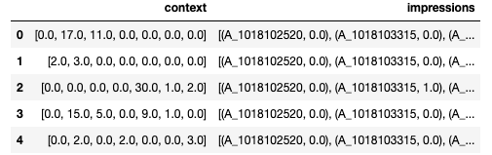
Methodology
The data used by our team was simulated data of a customer’s purchase pattern of products existing in certain product categories. It represents real life industry data.
Data was refactored and integrated into reference implementation and code was modified to address our use case.
Our use case requires the use of past user interactions to identify which products to recommend to a user. This meant that a contextual bandit algorithm was the best choice for our team.
The algorithm used by the team for our use case was the C3 Thompson Sampling algorithm developed by William.
C3 is an improved version of contextual bandit algorithm wherein it offers a transparent method of inference and exploration and the ability to utilize historical data even in the presence of non-stationary reward distribution.
Notes:
^{Input: Data, Model, Rationale}

Slide 5
Experiments
For the C3 algorithm, our use case and our dataset aligned with the MIND example showcased in the tutorial.
The sample dataset size used for this project was as follows
product categories = 7
unique products = 2382
customers = 1000
Product description was encoded using the BERT tokenizer and each product was represented by the BERT encoding of their description.
To improve the performance of our model we tuned the hyperparameters as follows:
num-of-layers = Reduced from 256 to 128 (complexity of input data)
weight_factor = Changed from 5 to 1 (higher num represents less exploration)
usage_ratio = 0.05 to 0.0005 (degree of subsampling, larger the dataset smaller the number)
Notes:
^{Hyperparameter tuning}

Slide 6
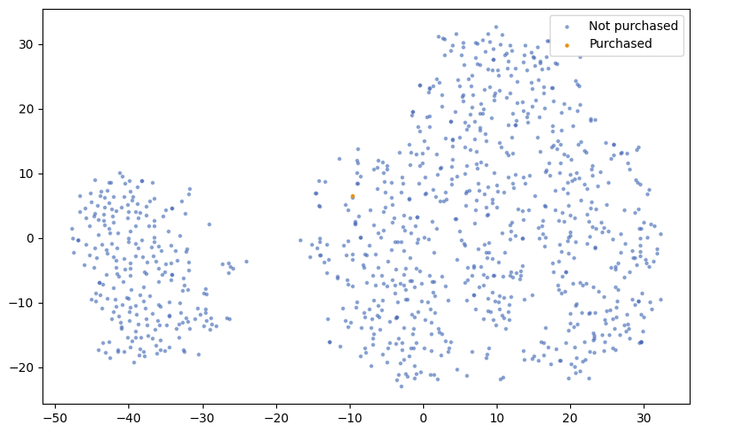
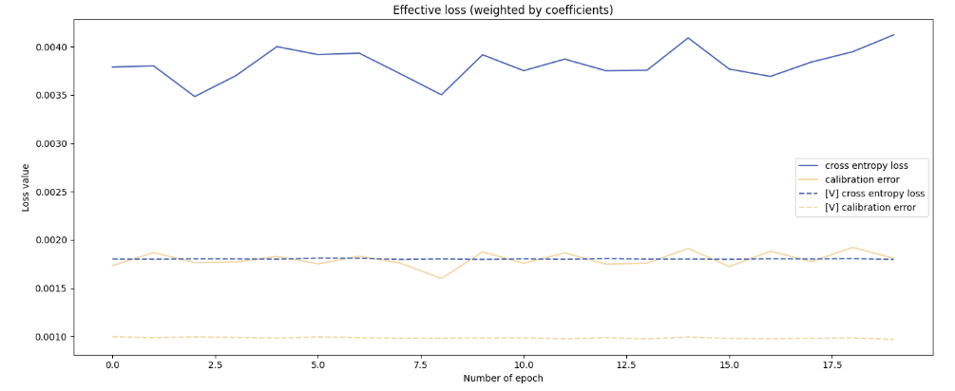
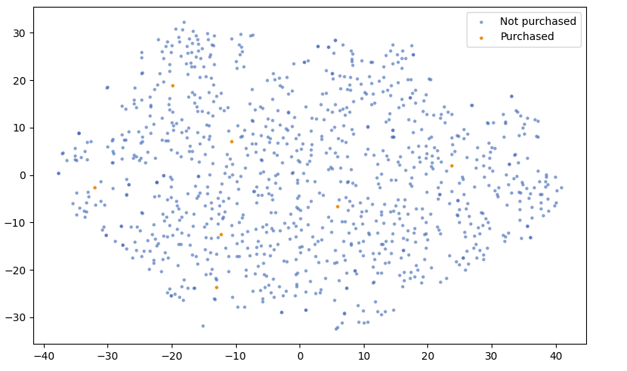
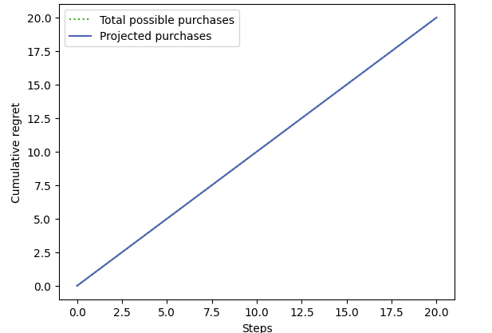
Results and Discussion
Original
Hyperparameter Tuning
Notes:
We initially trained the c3 model on the original sample dataset, as shown in the upper left graph, we observed this dataset is imbalanced, and it bias towards not purchased records.
First of all, we did experiments on hyperparameter tuning trying to get better performance. The training loss seems very low and fluctuate around 0.004, but when we used the trained model to perform prediction on the testing dataset, the projected purchases is very high as a diagonal line in the lower right graph. However, we expected this blue line to be close to horizontal.
During training, our model has trained on way more not-purchased records and resulted in biased trained model. To address this challenge, we re-create a more balanced dataset by grouping data into higher-level product categories and ensuring an approximately equal number of purchased and non-purchased records.

Slide 7
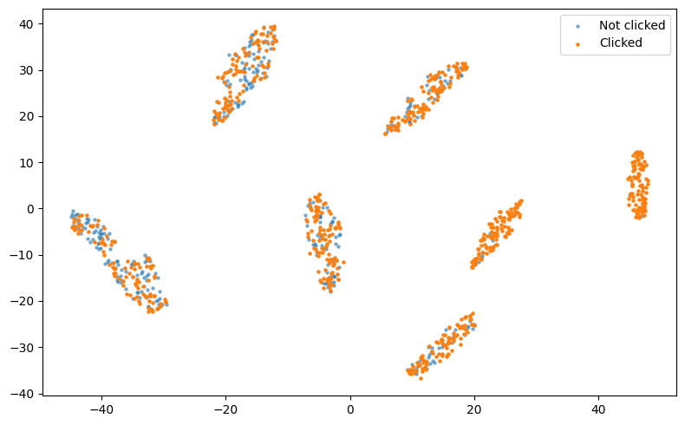
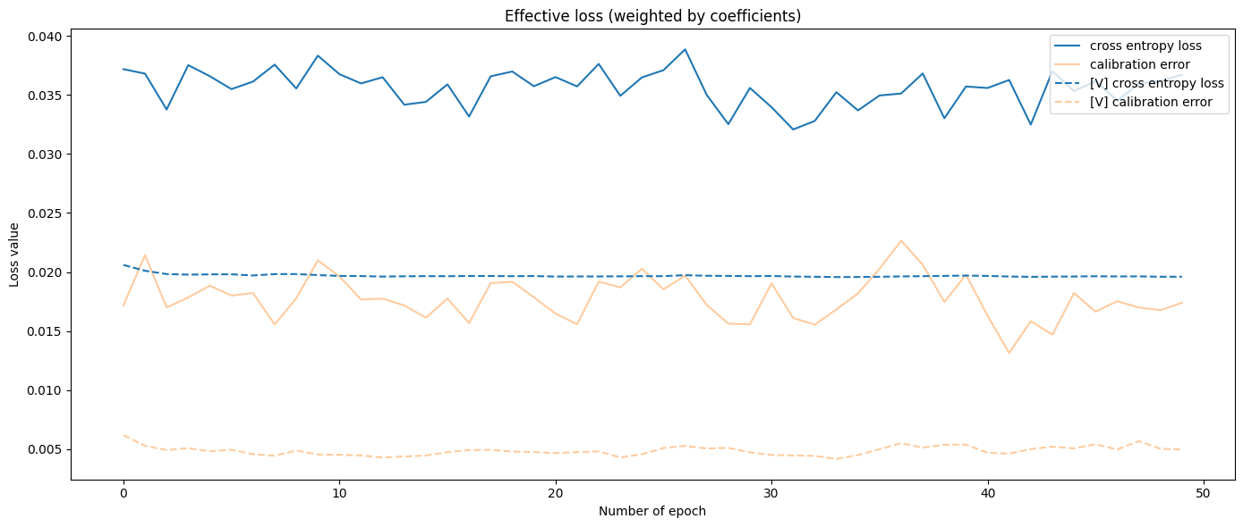
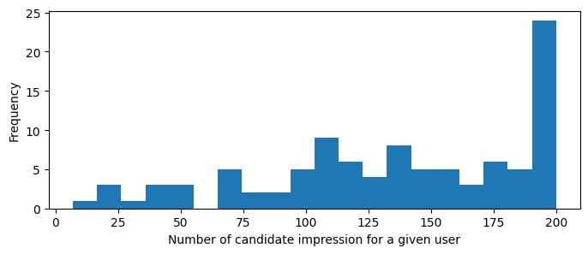
Training Data Visualization & Learning Curve
Notes:
We trained the C3 model on the processed dataset and observed that the training embeddings formed several clusters, with the right side containing more purchased data than the left.
The bottom left graph displays the frequency of candidate impressions per user, indicating that most users have around 200 candidate impressions.
Our training loss graph shows that the training loss value is between 0.035 and 0.04, indicating a very low loss.

Slide 8
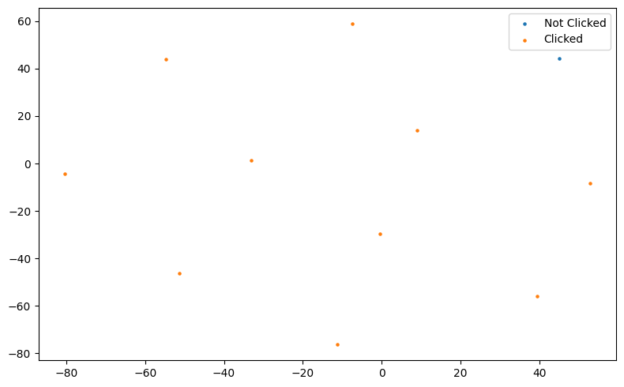
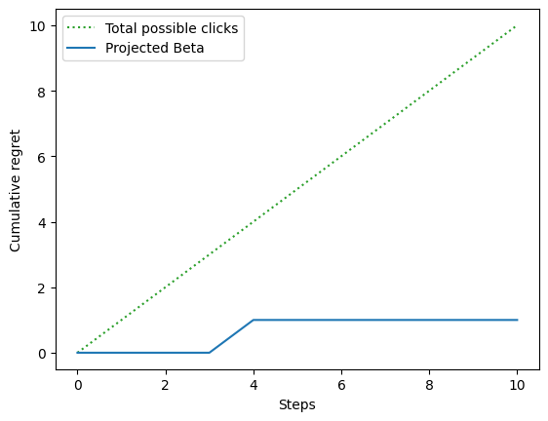
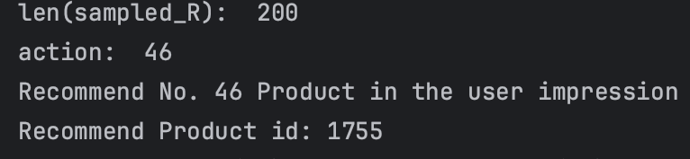
Evaluate on Testing Dataset
Notes:
We applied the best-trained C3 model to perform product recommendations on the testing dataset. For each user, we obtained the recommended action, corresponding to the recommended product ID within the candidate impression products. The model also outputs the optimal reward and regret, where regret is calculated as 1 - reward.
We then iterated through each user's data in the testing dataset and plotted the left graph. The total possible clicks represent the cumulative optimal reward, or the total possible products purchased by all users in the testing dataset. The project beta represents the cumulative C3 regret. We found that the cumulative regret is 1, which is quite low, indicating that our model only recommended one incorrect product that the user did not purchase. In most cases, the products recommended by the model were actually purchased by the users.
The right graph displays the buffered testing data embeddings. we initialized the buffer with a new point in the space. During inference,, then stored the embeddings along with the corresponding reward (0 or 1) for the selected recommended products or actions. The right graph shows only the inference results, excluding the initialized buffer point. As observed, there is one recommended product that the user did not purchase, while the other recommended products were purchased by the user.
reward, optimal_R = streamer.take_action(action)
print("reward: ", reward, "optimal_R: ", optimal_R)
cum_clicks.append(cum_clicks[-1] + optimal_R)
print("cum_clicks: ", cum_clicks)
cum_regret_c3.append(cum_regret_c3[-1] + (1 - reward))
print("cum_regret_c3: ", cum_regret_c3)

Slide 9
Industry Application and Future Work
Future Work
Experiment with different embedding models on MTEB leaderboards to generate product description text embedding
Find best model through hyper-parameter tuning
Improve text preprocessing process, sampling methods for training dataset
Apply model on real transaction datasets and balanced dataset
Industry Application
Fully personalized homepage and emailing
Optimized campaign promotions
Notes:
Future Work
Experiment with different embedding models on MTEB leaderboards to generate product description text embedding
Apply model on real transaction dataset and balanced dataset, revised the code to recommend single or multiple products for each customer, and output corresponding confidence score. We can even control whether or not to recommend products using exploration(sampled_R) or exploit (mean).
Industry Application
Fully personalized homepage and emailing (Deliver right products to right customers and keep customers engaged)
Optimized campaign promotions (deliver the products to targeted audiences who are most likely to want the products)

Slide 10
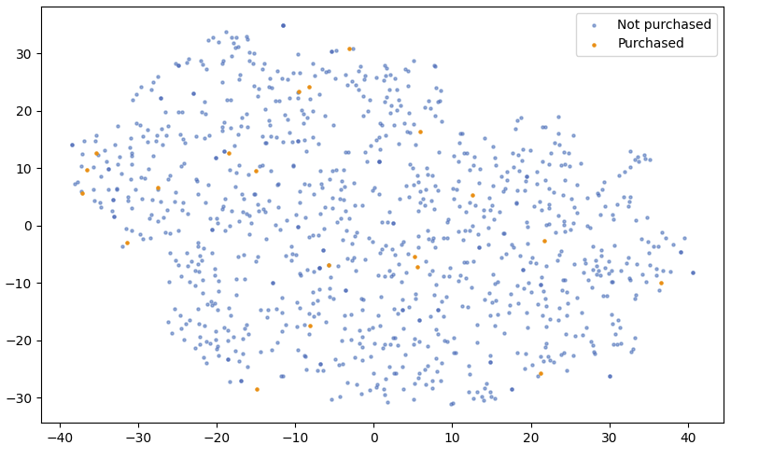
Hyperparameter Tuning & Reduce Sparsity

Slide 11
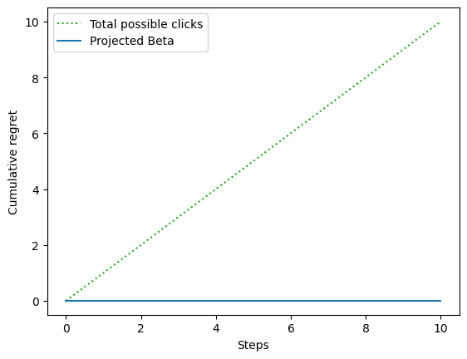
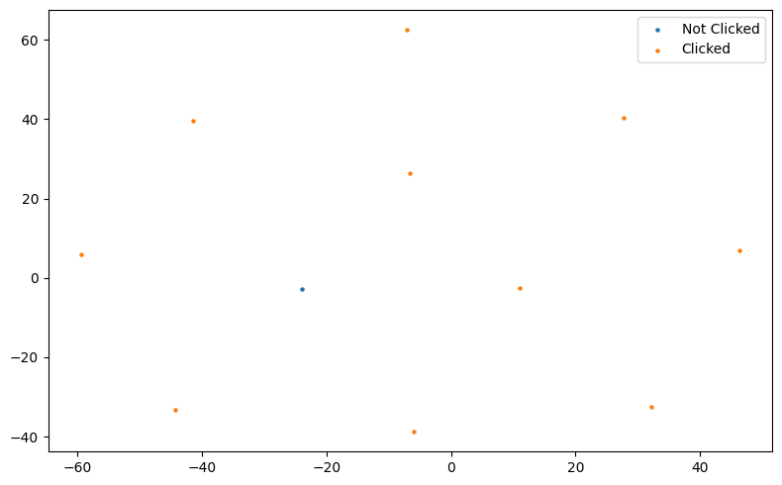
Evaluate on Validation Dataset
Notes:
Note total steps are only 11 reflecting 11 prediction results, in real application, it would be much larger, and therefore the prediction visualization has 11 data

